Slide 1
Literacy Technologies for English Learners
Do affordances affect outcomes?
Patrick Proctor
Boston College
Samantha Daley
University of Rochester

Slide 2
Goals
Provide a framework for thinking about evolution of digital literacy platforms
ACCESS, PROCESSING, INTERNALIZATION
Describe how this framework applies to a set of digital literacy platforms
Designed from a bilingual perspective
Consider ways to make inferences about how affordances affect outcomes for students using digital literacy platforms
For students generally, and bilingual students specifically
Look to the future
Access features are ubiquitous unlike in the past

Slide 3
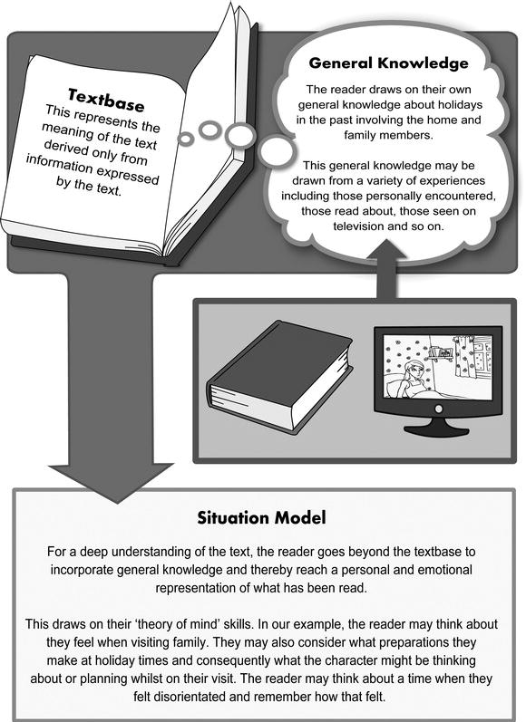
Converging models of reading comprehension
Simple Views of Reading
(Hoover & Gough, 1990; Scarborough, 2001)
Construction-Integration
(Kintsch, 2004)

Slide 4
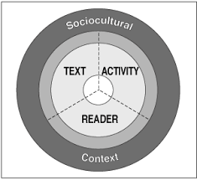
RAND Reading Study Group (Snow, 2002)
Model for Digital Literacy Platforms (Dalton & Proctor, 2007, 2008)
Language modalities include:
Reading, Writing, Speaking, Listening, +
Visual

Slide 5
Model for Reading Motivation
Self-efficacy as reader
Intrinsic motivation
Reading-related choices, engagement, persistence
Prosocial goals for reading
Louick, Leider, Daley, Proctor & Gardner, 2016
Proctor, Daley, Louick, Leider, & Gardner, 2014
Wigfield & Guthrie, 1997; Wigfield & Eccles, 2002

Slide 6
Framework for Digital Literacy Platforms
ACCESS
Supporting learner to access text content accounting for maximum learner variability
Potential barriers: e.g., visual impairments, decoding challenges
Leveraging existing capabilities: e.g., alternative modalities
PROCESSING
Getting the learner to metacognitively process language and literacy to better understand their relation to learning and comprehension
Potential barriers: e.g., emergent English proficiency
Leveraging existing knowledge: e.g., native language proficiency
INTERNALIZATION
Getting the learner to internalize learning, to feel expert and engaged in the content
Potential barriers: e.g., limited reading proficiency
Leveraging existing knowledge: e.g., high-interests texts

Slide 7
Overview of Projects
Digital Literacy Platforms
Access
Internalization
Processing
Thinking Reader for English Language Learners (TRELL)
1-year, Hewlett Foundation funding
Comprehension + Vocabulary supports
Improving Comprehension Online (ICON)
3-year, Institute of Education Sciences funding
Add formative comprehension + vocabulary assessments
Udio
5-year, Office of Special Education Programs funding
“Emerging technologies” to support middle grade students with reading difficulties
Focus on engagement, motivation, self-efficacy

Slide 8
Evolution of Digital Literacy Platforms

Slide 9
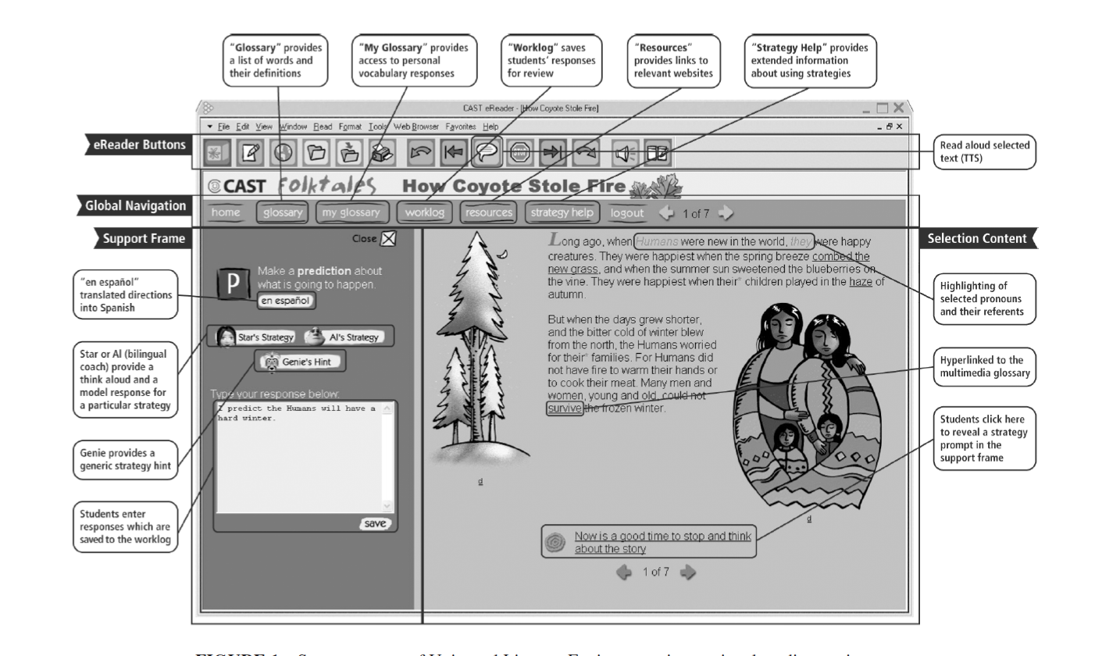
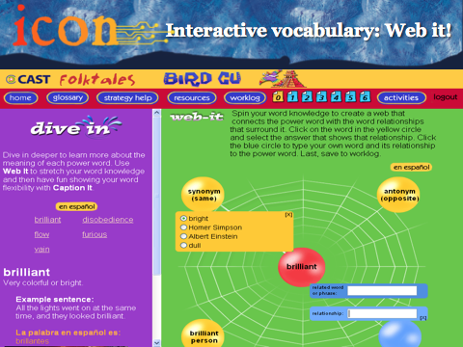
13-Year Evolution
Access & Processing
Internalization
TRELL
2003-2004
ICON
2005-2008
Udio
2011-2016

Slide 10
TRELL

Slide 11
ICON

Slide 15
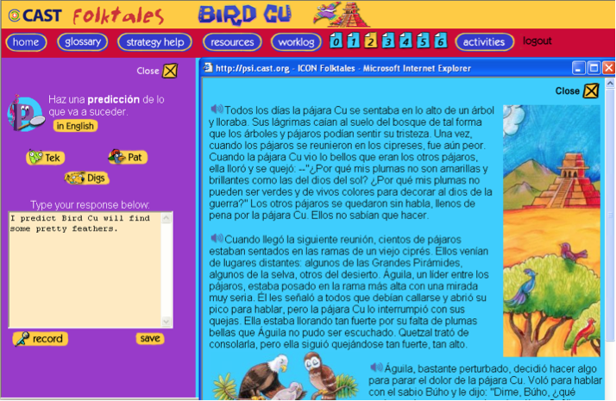

Slide 16
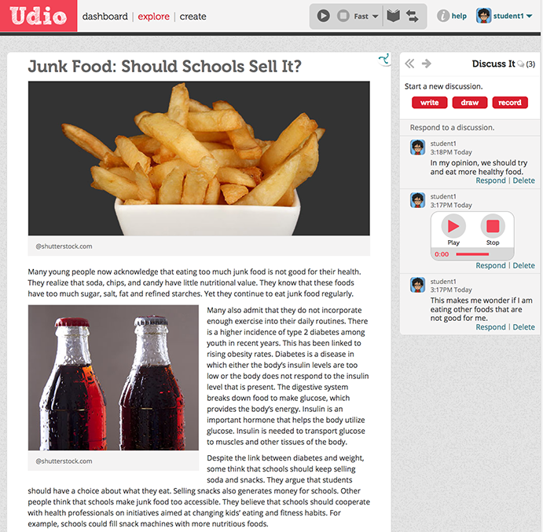
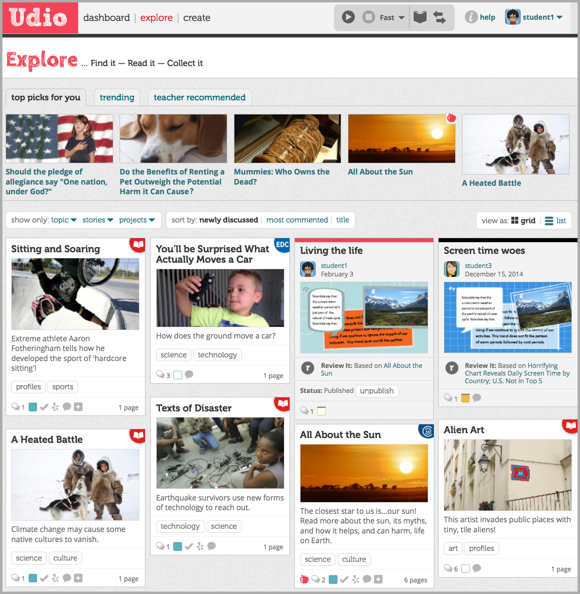
Udio: Access & Process as Assumed

Slide 17
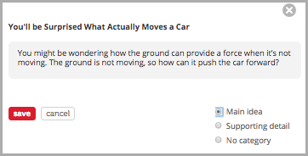
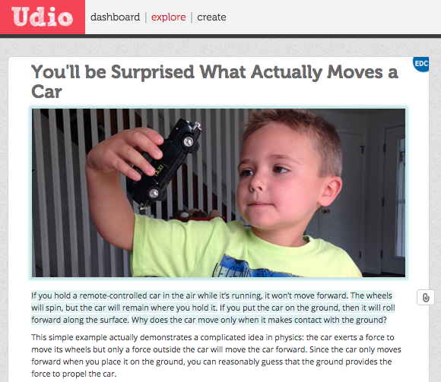
Evolution of Access & Process Features

Slide 18
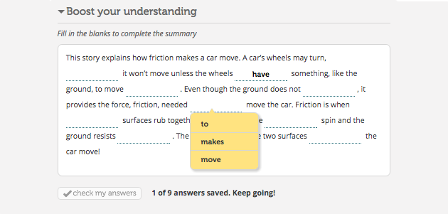
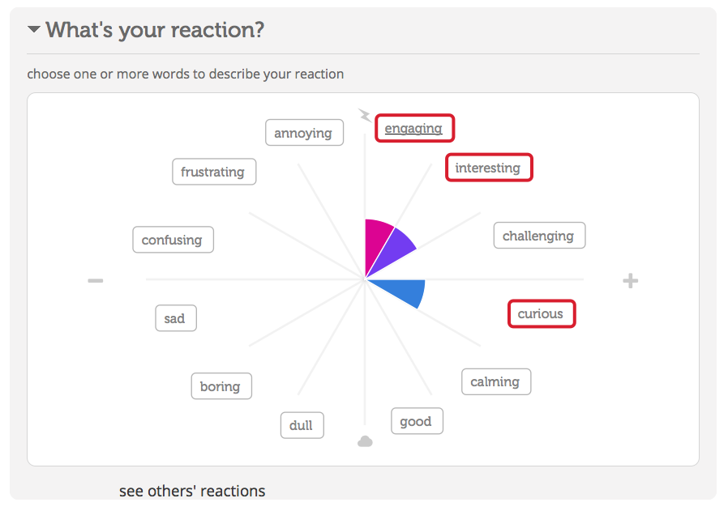
Evolution of Access & Process Features

Slide 19
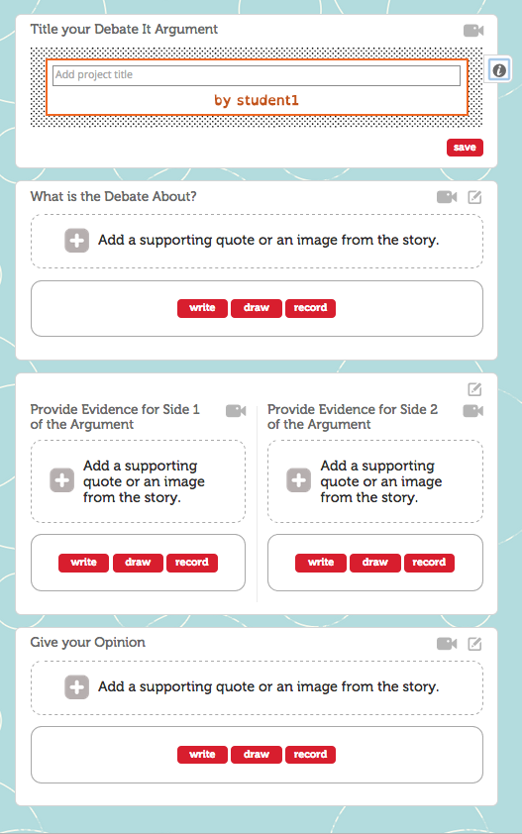
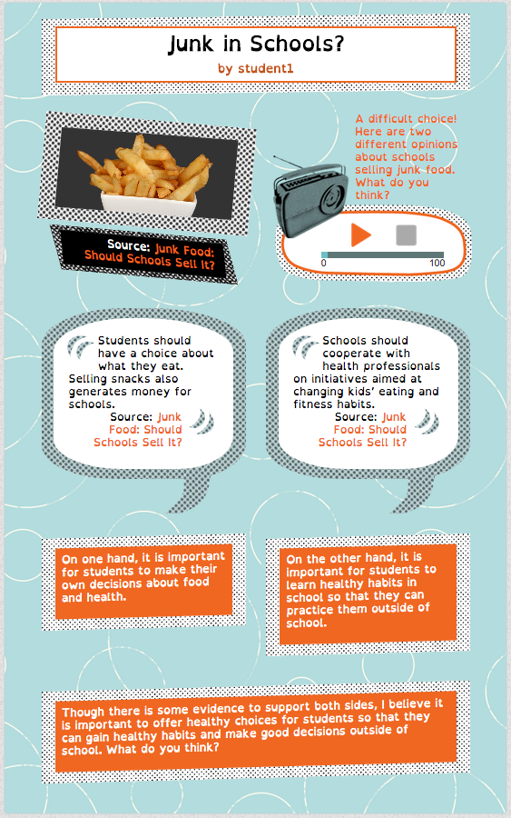
Toward Internalization: Writing in the Service of Reading

Slide 20
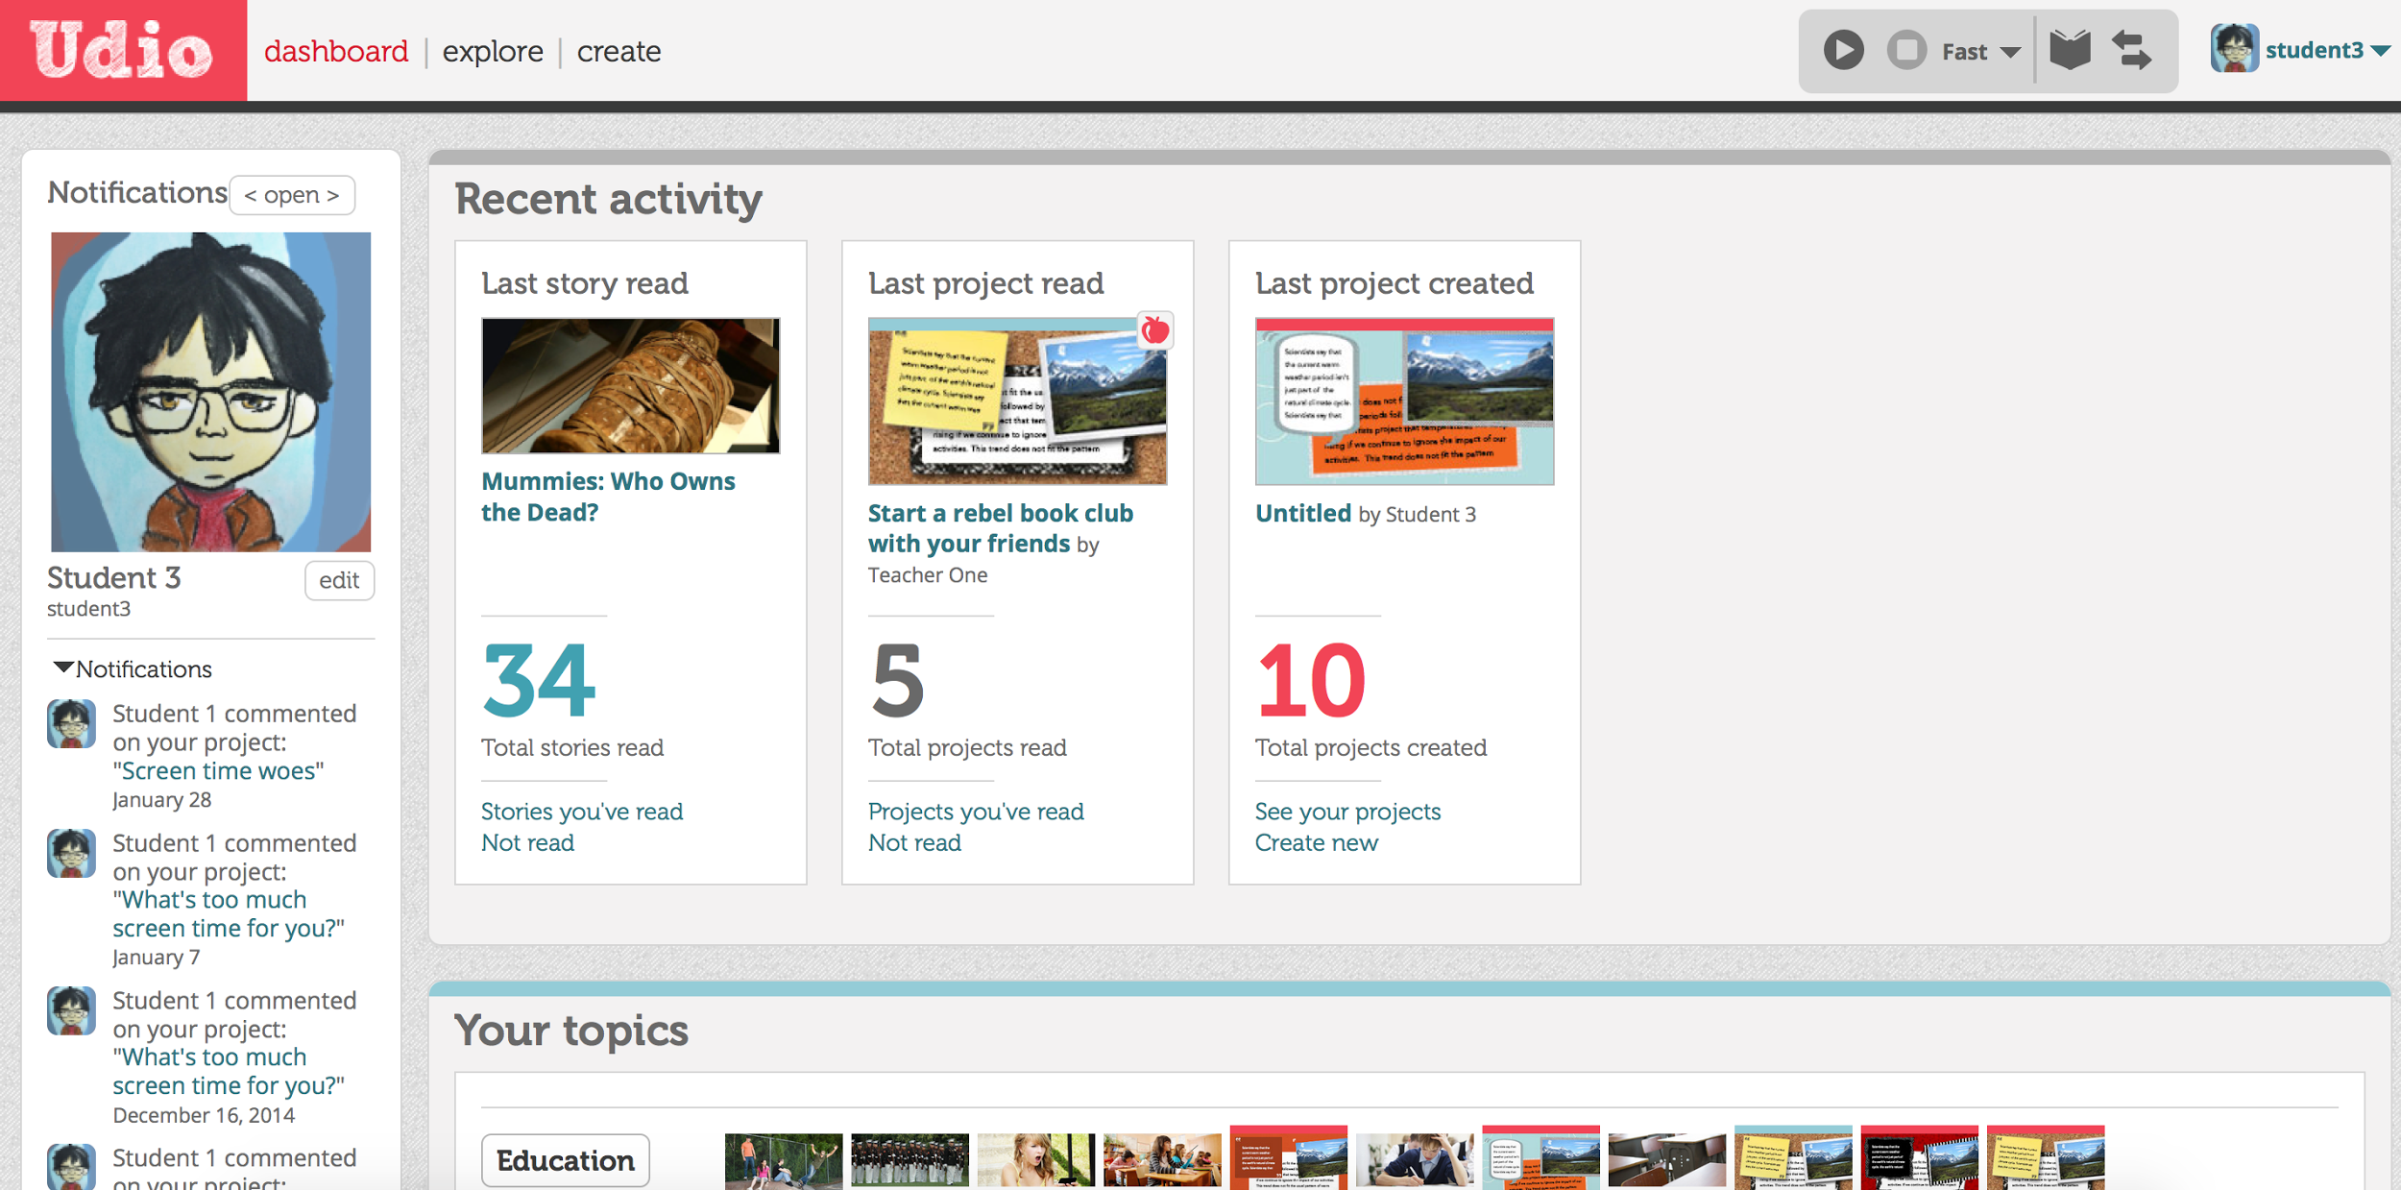
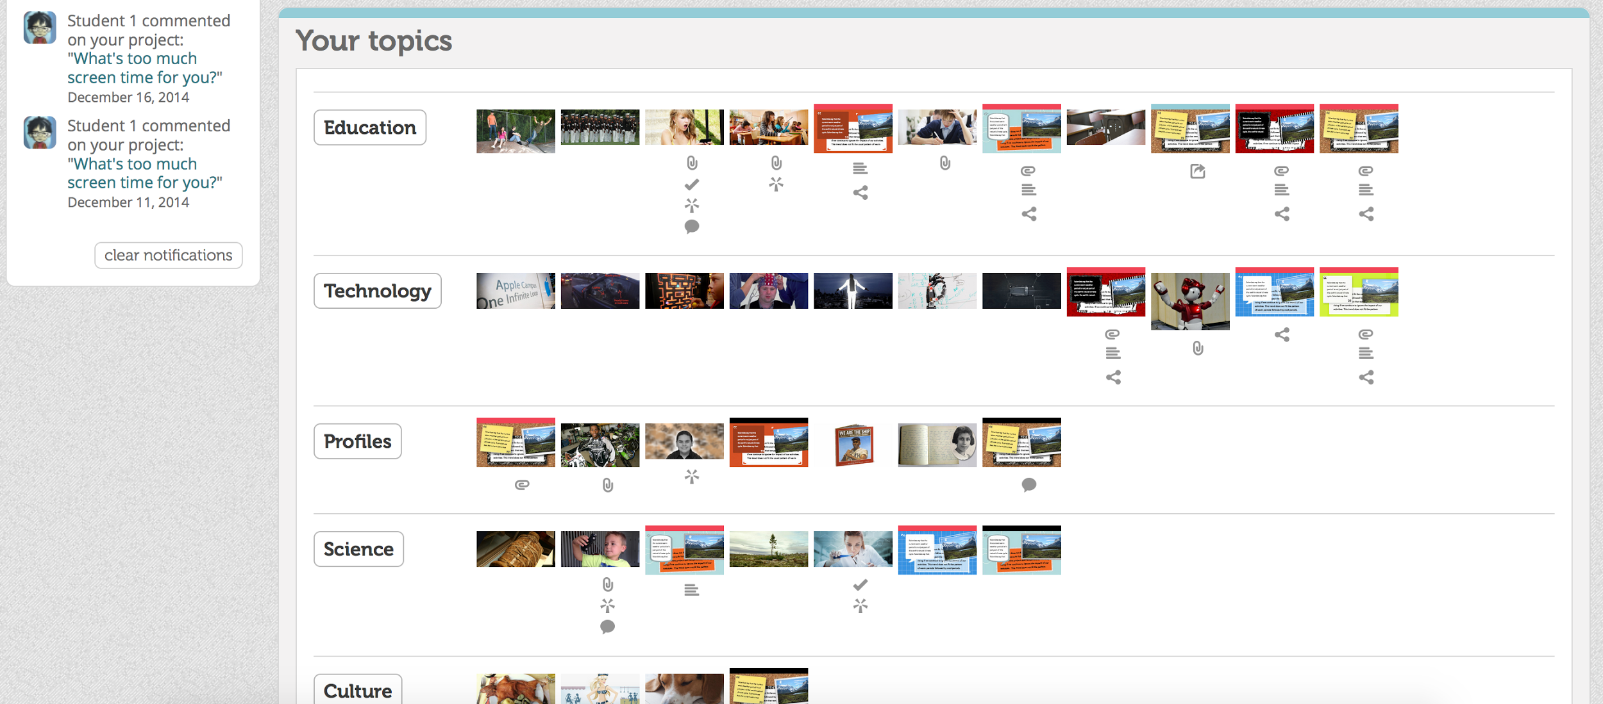
Toward Internalization: Cultivating a Reading Mindset

Slide 21
Evolution of Data & Analytics Affordance Use and Literacy Outcomes

Slide 22
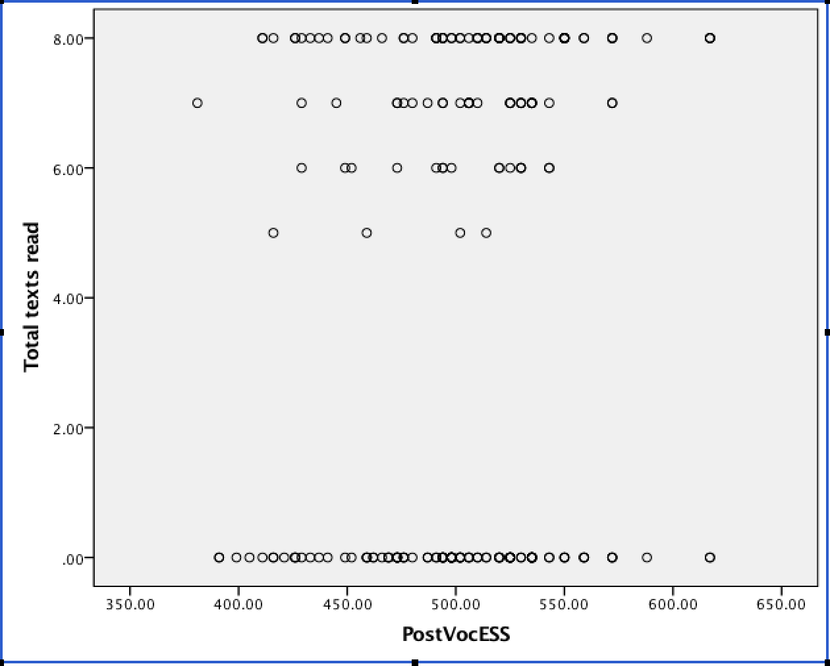
Richer Affordances and Improved Technologies

Slide 23
TRELL Analytic Approaches
4-week study, 30 students (Proctor, Dalton, & Grisham, 2007)
Reading and Reading Vocabulary as outcomes (Gates-MacGinitie)
Digital Feature Use
Total texts read
Coach use
Glossary use
Glossary posts

Slide 24
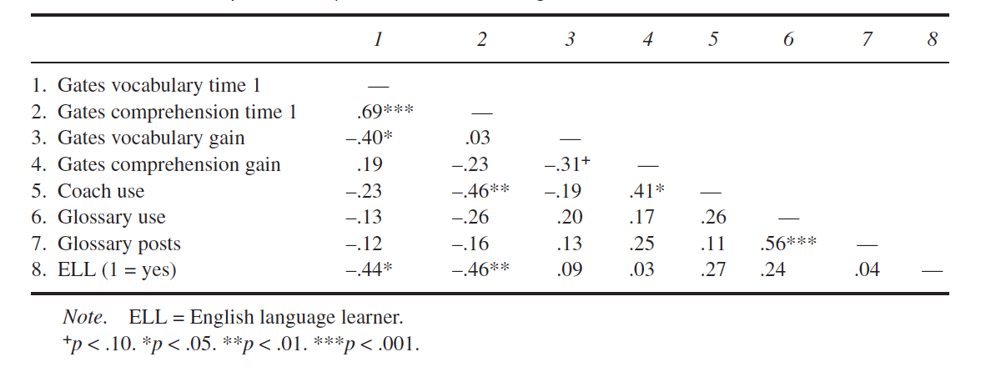
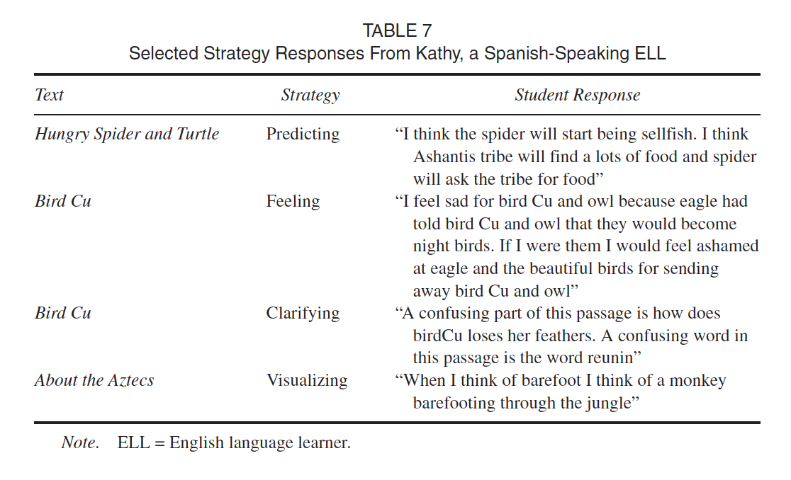
TRELL Analyses

Slide 25
ICON Analytic Approaches
Goal 2 IES, 16-week field trial (Dalton et al., 2011; Proctor et al., 2011)
N = 240
Measures:
Reading and Vocabulary (Gates-MacGinitie)
Researcher-designed vocabulary breadth and depth
Digital Feature Use
Total texts read (text reading as feature use)

Slide 26
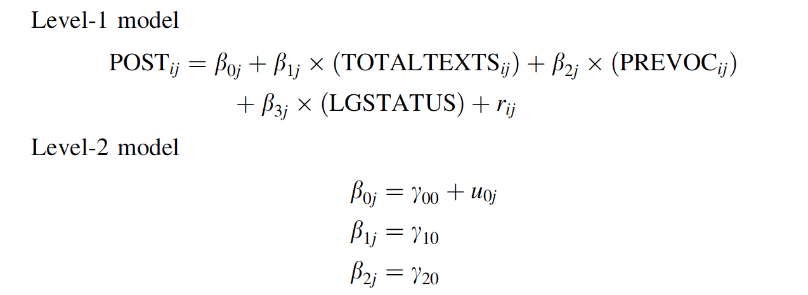
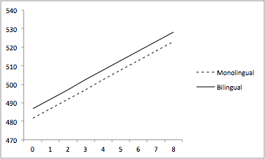
ICON Analyses: HLM with pre-test autoregressor
Post-test Gates Vocabulary
Total Texts Read

Slide 27
Udio: Literacy Feature Use: One class, over time

Slide 28
Affordances that Support Internalization

Slide 29
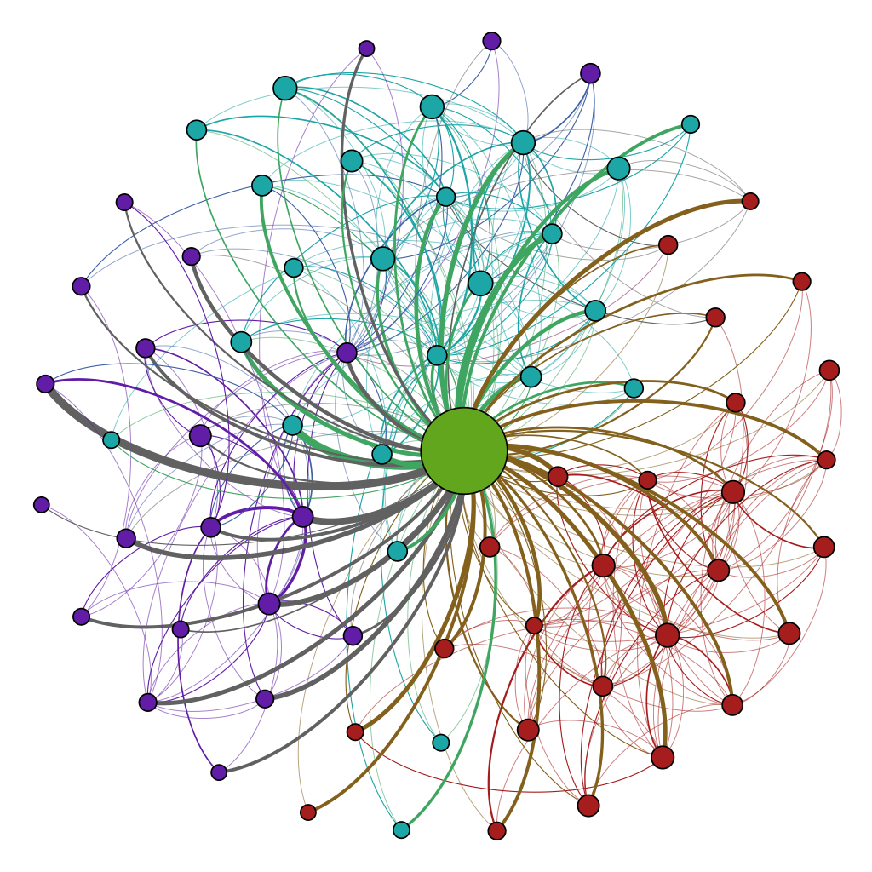
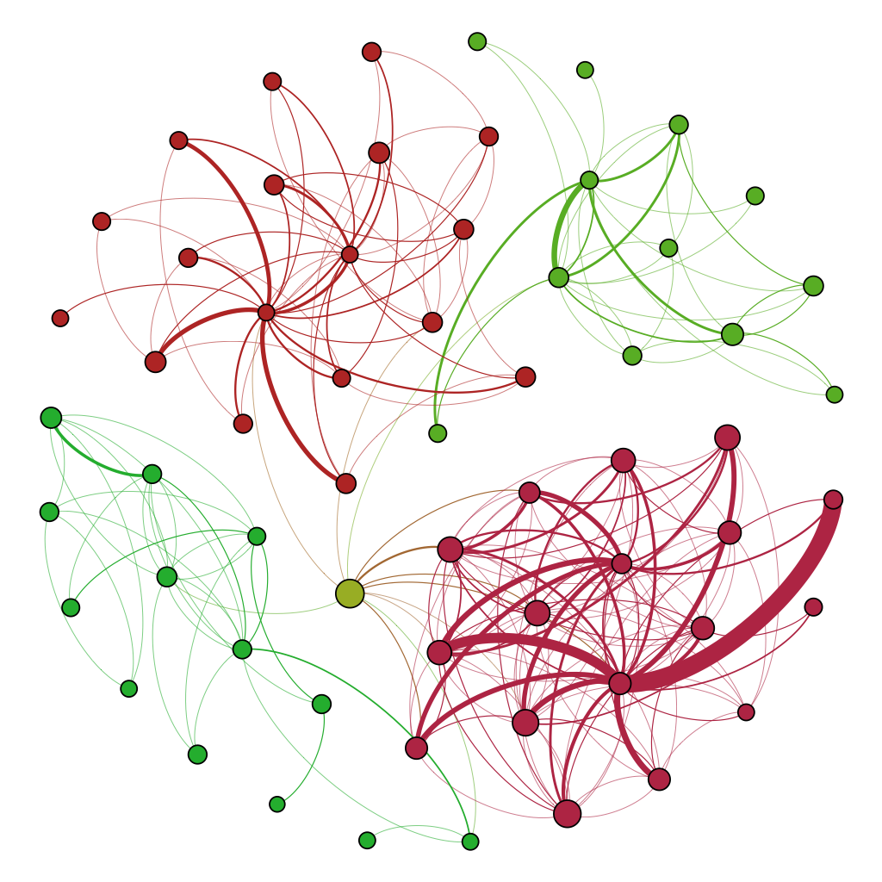
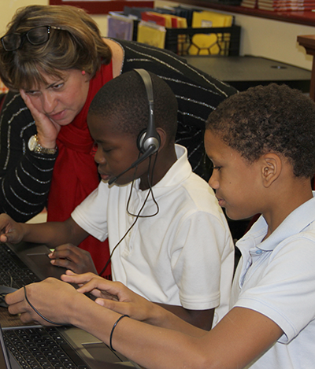
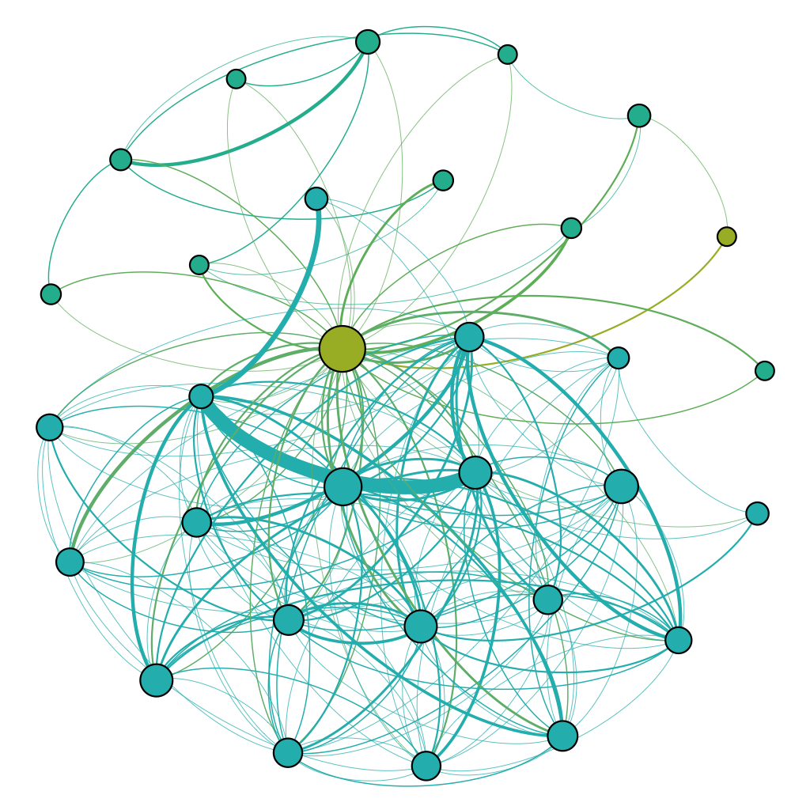
Affordances that Support Internalization

Slide 30
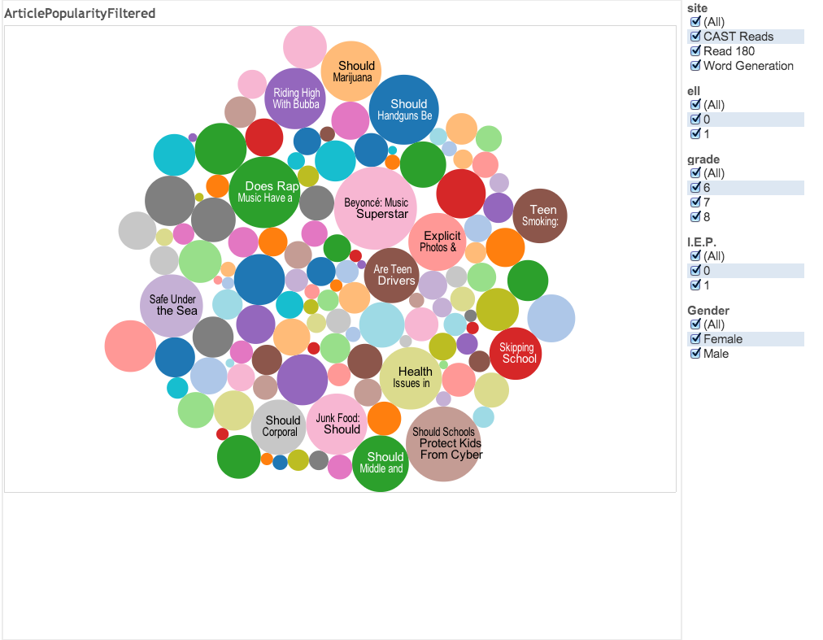
Popular Articles for the Whole Sample

Slide 31
Popular Articles for English Learners
Notes:
Indication of the power of choice

Slide 32
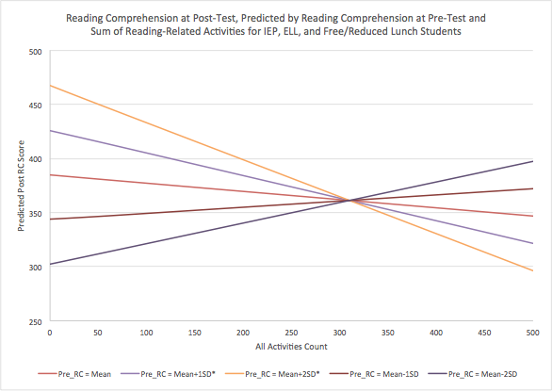
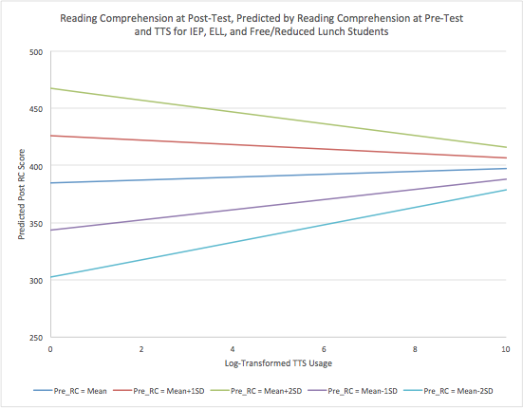
New Analytics + Traditional Analysis
Notes:
N=355 (in Udio full condition); Across whole sample: 51% IEP, 24% ELL, 74% FARMS,

Slide 33
Future directions
Students
Ubiquity of affordances
Intended and unintended consequences
Are kids learning to NOT read?
Teachers
Udio data confirm teachers are quite different from each other
Environment affords broader variability
Researchers
Tension between integration of “big data” and standard intervention procedures
RCTs, QEDs, and feature use as predictors is crude
Traditional “outcomes” are distant from technology-based interventions
How should the idea of outcomes evolve in this new landscape?

Slide 34
Thank you! proctoch@bc.edu sdaley@warner.rochester.edu

